Slide 1
Filing in java
Abdul Haseeb

Slide 2
Java I/O
Java I/O (Input and Output) is used to process the input and produce the output.
Java uses the concept of a stream to make I/O operation fast.
A stream is a sequence of data. In Java, a stream is composed of bytes:
Stream of River

Slide 3
java.io
The java.io package contains all the classes required for input and output operations.

Slide 4
Streams
In Java, 3 streams are created for us automatically. All these streams are attached with the console.
1) System.out: standard output stream
2) System.in: standard input stream
3) System.err: standard error stream

Slide 5
Input/Output Stream
Input stream to read data from a source; it may be a file, an array, peripheral device
An output stream accepts output bytes and sends them to some sink.

Slide 6
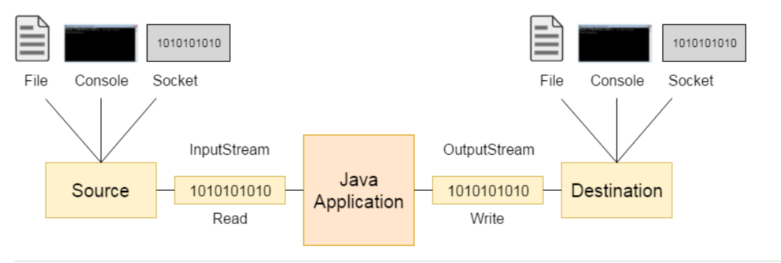
Input Stream vs Output Stream

Slide 7
FileOutputStream Class
A child of OutputStream class
If you have to write primitive values into a file:
Use FileOutputStream class.
For writing Raw Bytes (unencoded bytes)

Slide 8
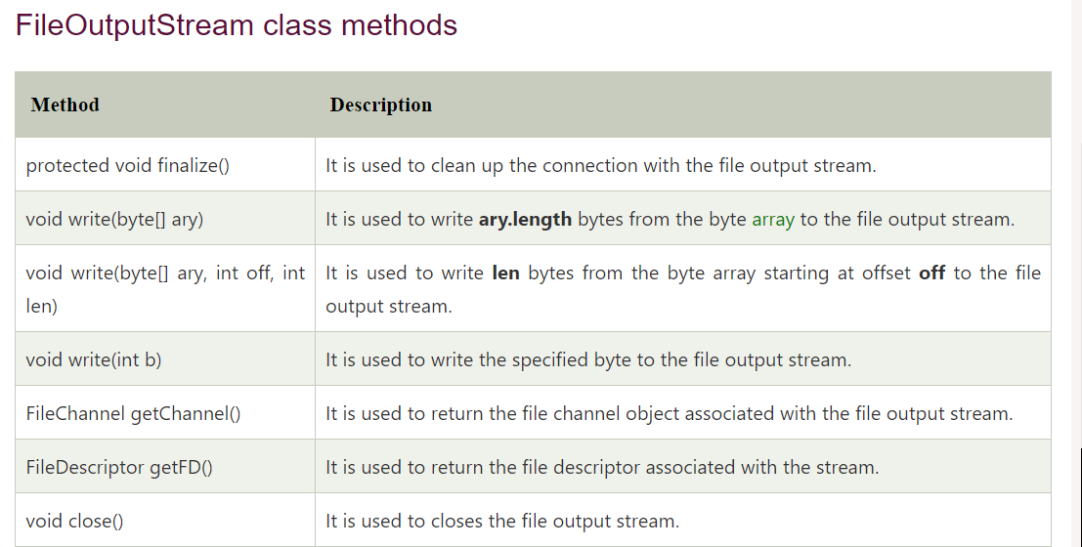

Slide 9
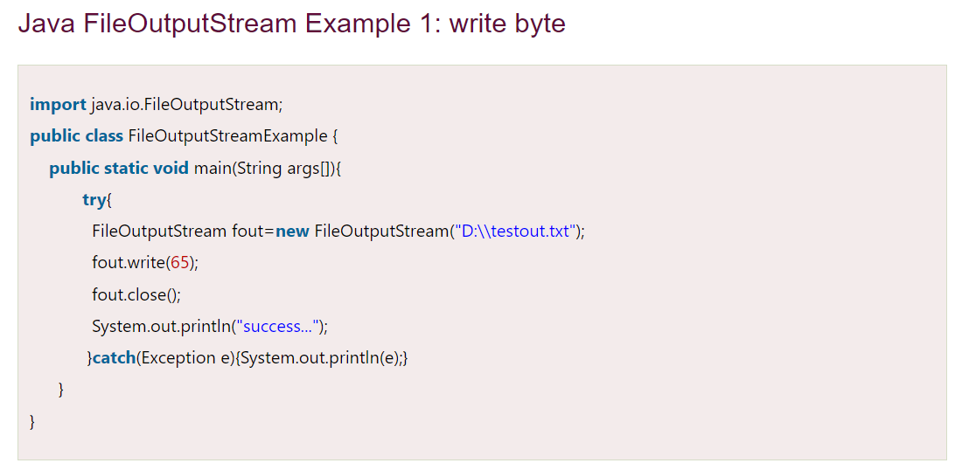

Slide 10
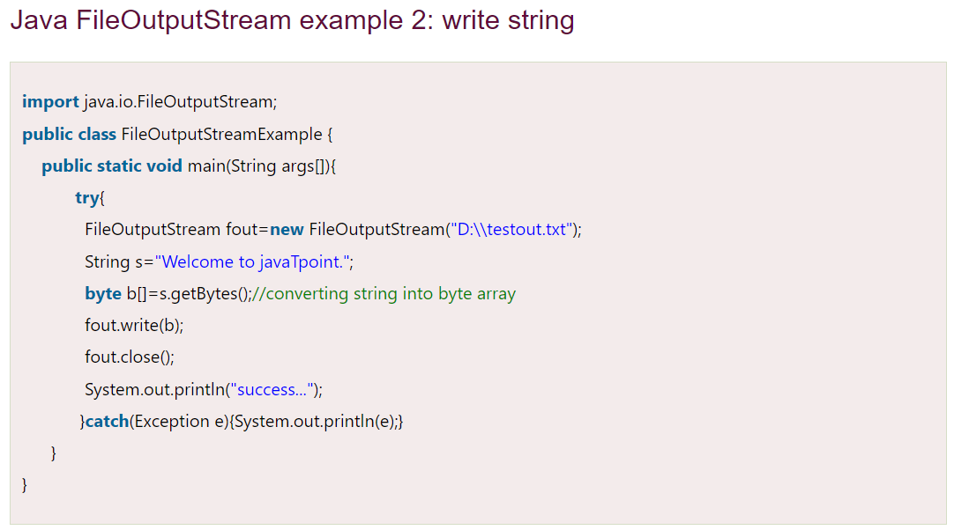

Slide 11
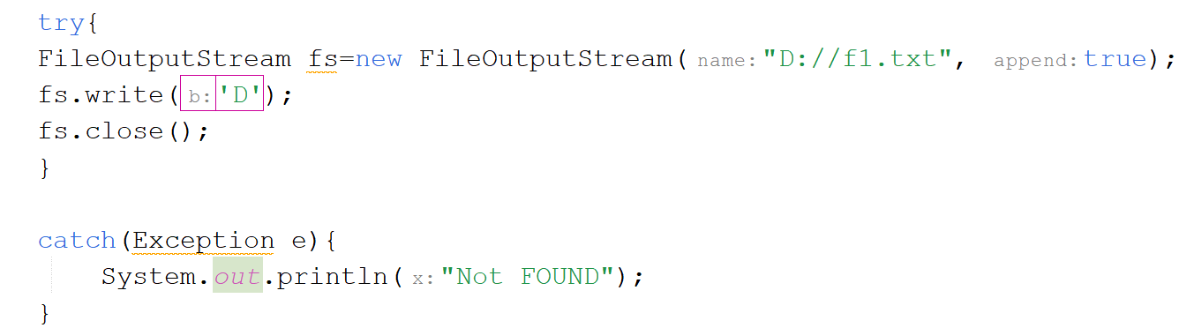
Code to append data

Slide 12
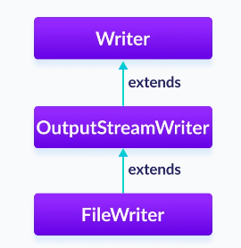
FileWriter
For character-oriented data, it is preferred to use FileWriter than FileOutputStream.
It automatically performs character encoding
Can write strings directly

Slide 13
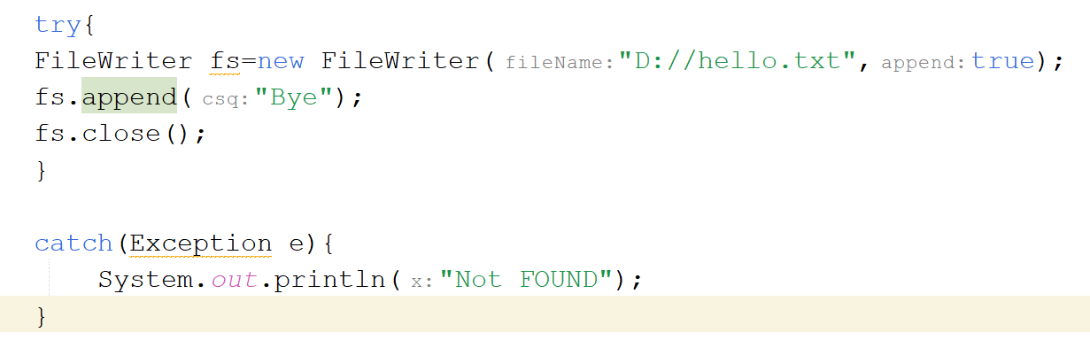
FileWriter Code

Slide 14
FileInputStream
Java FileInputStream class obtains input bytes from a file
For reading character streams, FileReader can be used

Slide 15
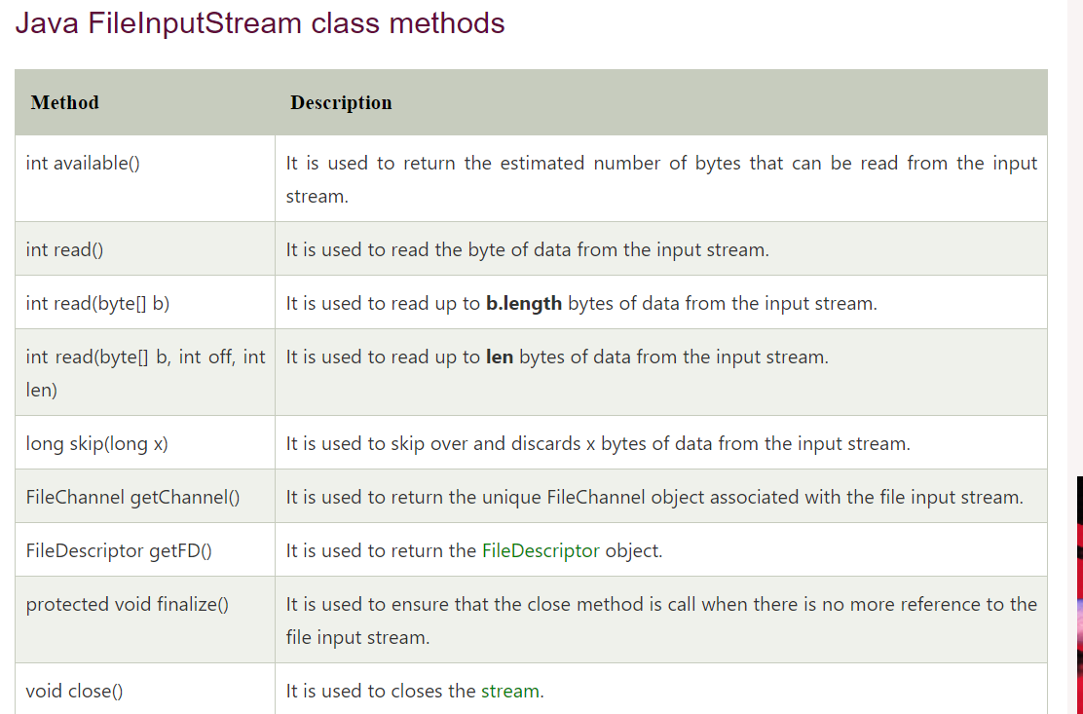

Slide 16
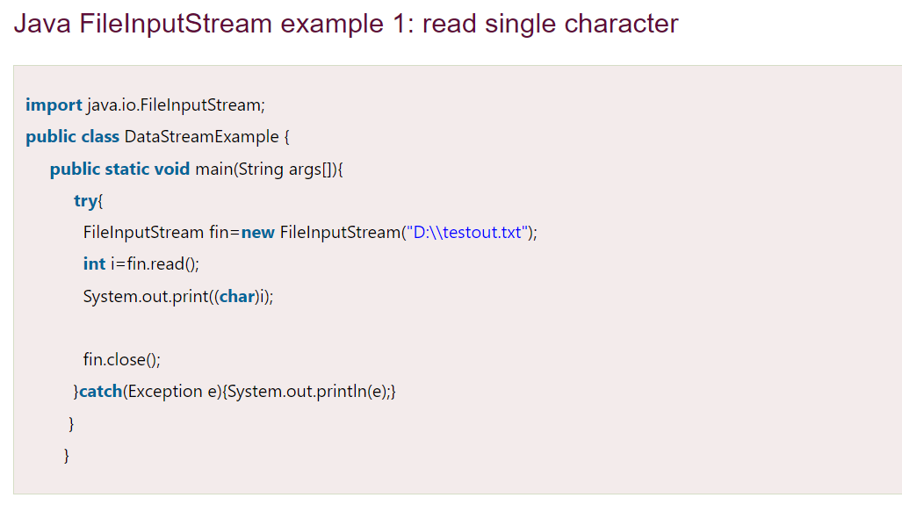

Slide 17
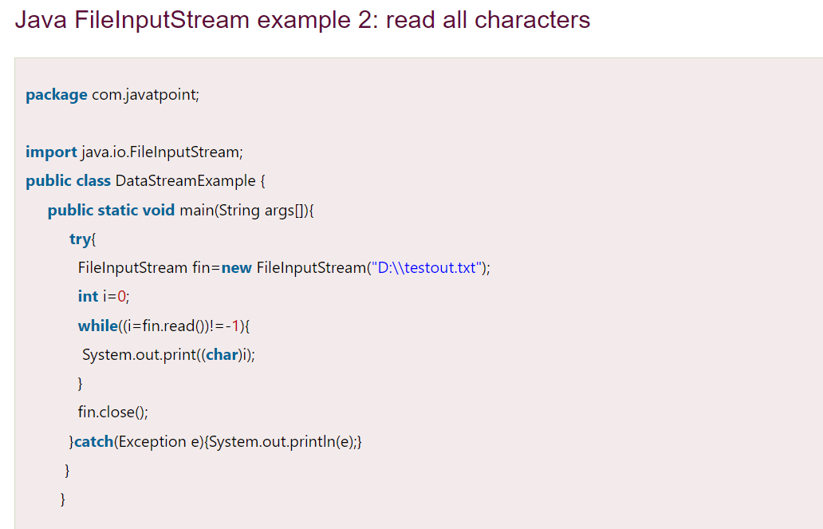

Slide 18
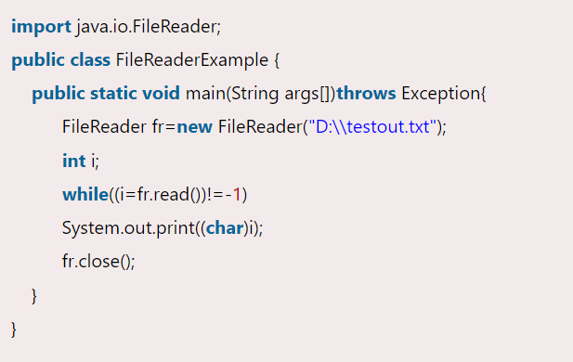

Slide 19
Buffered Output and Buffered Input Stream
FileStreams read a block of data, if file is large there are many blocks to read
Buffered Streams read larger chunks of data, and store them inside buffers
Calls to system are reduced
Improves performance

Slide 20
Code:
FileOutputStream fout= new FileOutputStream(“F://f1.txt”);
BufferedOutputStream b1=new BufferedOutputStream(fout);
string line=“Working with Buffered Streams…”;
byte b[]=s.getbytes();
b1.write(b);
b1.close();
fout.close();

Slide 21
Code:
FileInputStream fin= new FileInputStream(“F://f1.txt”);
BufferedInputStream b1=new BufferedInputStream(fout);
string line=“Working with Buffered Streams…”;
int ch;
while(ch=b1.read()!=-1)
S.O.P((char)ch)
b1.close();
fin.close();

Slide 22
try {
FileReader fileReader = new FileReader(filePath);
BufferedReader bufferedReader = new BufferedReader(fileReader); String line;
while ((line = bufferedReader.readLine()) != null) { System.out.println(line); }
bufferedReader.close();
fileReader.close(); }
catch (IOException e)
{ System.out.println("Error reading file: " + e.getMessage());}

